Slide 1
Virtualizer Studio: TLM Creation
Quickstart Training – Model Behavior Implementation
© 2024 Synopsys, Inc. All Rights Reserved
Notes:
Welcome to the module 3 of the TLMC QuickStart training - Model Behavior Implementation!

Slide 2
CONFIDENTIAL INFORMATION
The information contained in this presentation is the confidential and proprietary information of Synopsys. You are not permitted to disseminate or use any of
the information provided to you in this presentation outside of Synopsys without prior written authorization.
IMPORTANT NOTICE
In the event information in this presentation reflects Synopsys’ future plans, such plans are as of the date of this presentation and are subject to change. Synopsys is not obligated to update this presentation or develop the products with the features and functionality discussed in this presentation. Additionally, Synopsys’ services and products may only be offered and purchased pursuant to an authorized quote and purchase order or a mutually agreed upon written contract with Synopsys.

Slide 3
Agenda
Introduction
  Virtualizer Studio Overview + TLM Creation Flow
Part 1: Model Skeleton Creation
  Model interfaces, memories, registers, build settings, IP-XACT import, etc.
Part 2: Test Driven Design Methodology
  Unit testing framework, test utilities, functional coverage, etc.
Part 3: Model Behavior Implementation
  Default and custom callbacks, continuous assignments, etc.
Part 4: Model Debugging
  SystemC debugging, using FastTrack messages, source code debugging, etc.
Part 5: Import of Existing SystemC Models
Part 6: Model Integration in Virtual Prototype Design
Notes:
Look into the overview to get an insight into the training contents.

Slide 4

Objectives
After completing this module, you should be able to:
Implement Model Behavior in TLM Creator using the following:
  Setting the Behavior Callbacks in the Memory Map Tab
  Specifying the Protocol Attributes in the Interfaces Tab
  Selecting and Configuring Reuse Objects in the Instances Tab
    More on the supported Reuse Objects – Hierarchy

Slide 5
Model Behavior Implementation
  Memory Map Tab – Behavior Callbacks
  Interfaces Tab – Protocol Attributes
  Instances Tab – Selecting and Configuring Reuse Objects
  Reuse Objects – Hierarchy
Notes:
In this section, we will learn about the model behavior implementation flow.

Slide 6
Model Behavior Implementation
This module highlights how to implement the behavior of a TLM Model.
For example:
What happens if a register is written to, or
How to define the internal functionality of a model
To reduce the amount of code you have to write manually in SystemC, you can use features of the TLM Creation perspective of Virtualizer Studio:
Behavior Callbacks
Continuous Assignments
Reuse Objects, etc.

Slide 7
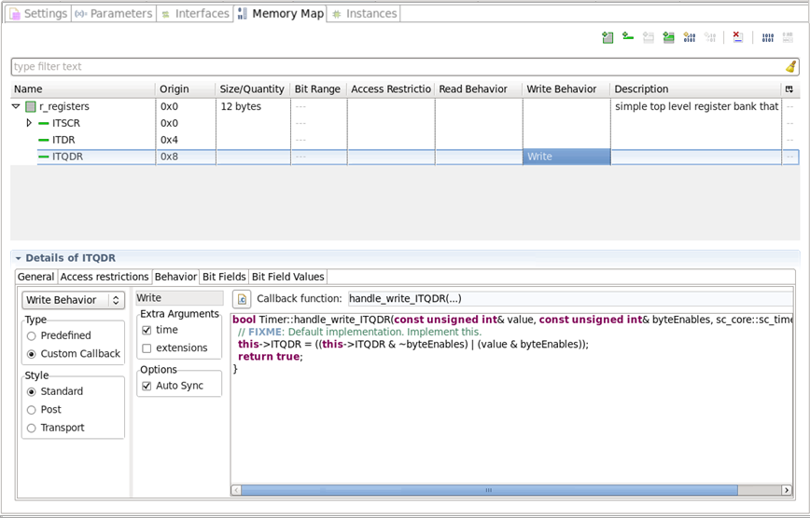
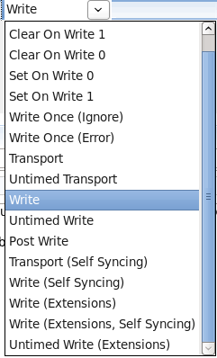
Memory Map Tab – Behavior Callbacks
Link to open source code editor
Select Behavior: Read, Write, Debug
Behavior
Select Type
Select Arguments for Callback
Peephole view into actual source code
Select Style
Select Registration Options
Notes:
The Behavior subtab is used to define the model behavior when a certain memory object is accessed via a TLM2 transaction.
First you select which behavior to define: read, write or debug. This can be done through the dropdown in the subtab or by selecting the column in the table. It is possible to select from a few predefined behaviors or to create a custom implementation. There are different behavior styles:
Standard - with a simplified set of arguments
Post - a behavior that will be executed after the default load/store behavior of a TLM2 transaction or
Transport - which gives access to the full TLM2 transaction for this memory object.
Next it is possible to fine tune the arguments of the callback and to define optional behavior of the callback.
The Auto Sync option determines whether the callback will be registered as auto-syncing (enforcing SystemC synchronization before and after the callback) or as self-syncing where the synchronization will be handled in the callback implementation. The default setting is autosyncing.
The behavior setup can also be selected from the dropdown in the memory object table.
When saving the design a default implementation of the code will be generated in the source code file of the model. The implementation of the behavior can be accessed through the peephole view, this view is in sync with the eclipse source code editor of the model, any change in the eclipse source code editor will be reflected immediately in the peephole view and vice versa. The peephole view provides with the same editing capabilities as the eclipse source code editor: syntax highlighting, auto-completion, error marks etc.
Via the hyperlink button at the top the source code editor can be opened at the location of the callback implementation.

Slide 8
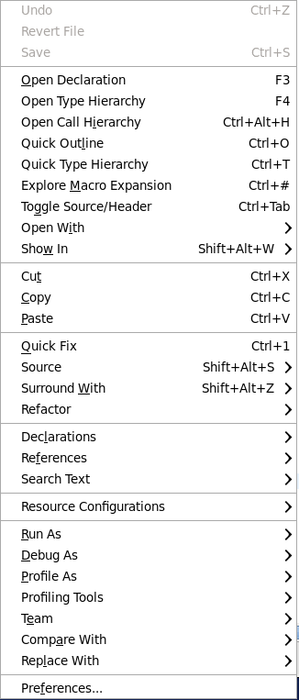
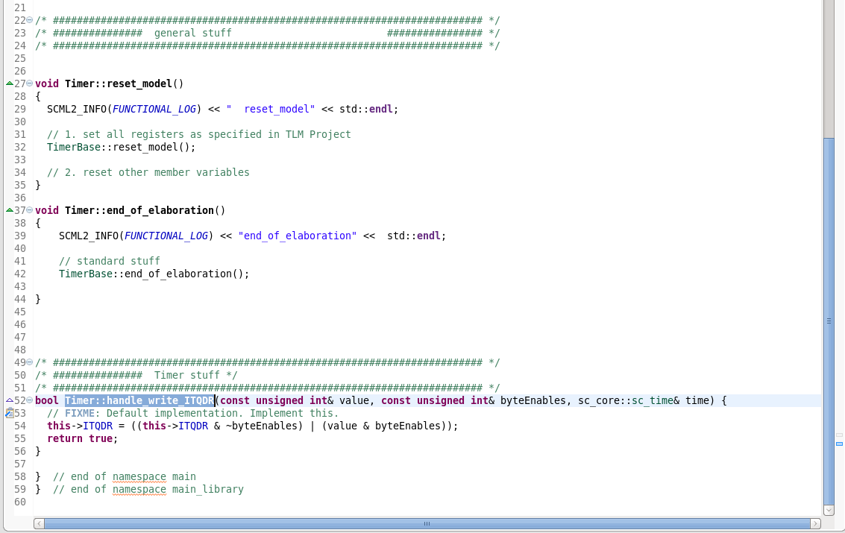
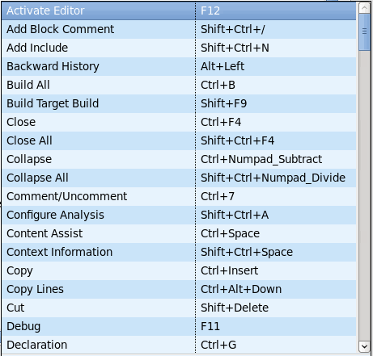
Memory Map Tab – Behavior Callbacks
Context menu displays rich set of features of the CDT Source Code Editor
Keyboard Shortcuts list gets displayed with Ctrl-Shift L
Refer to the link for a complete list of key board shortcuts for CDT
http://www.cheat-sheets.org/saved-copy/eclipseCDT8.0-cheatsheet.pdf
Source code for the Write callback function for ITQDR opens in the Editor
Notes:
When the source code file is opened after pressing the hyperlink button the file is opened at the location of the callback implementation with the function highlighted.
It is possible to move the code to other files, the hyperlinking will pick up on the new location. Files that are added to the model project in eclipse will be picked up by the model build.
The CDT source code editor of Eclipse comes with a rich set of features. Right-click in the Source code editor, to use features from the context menu such as, code browsing, code refactoring, code completion, searches, and so on. For may features there are keyboard shortcuts, a list of shortcuts is displayed when using Control Shift L. A list of key board shortcuts for CDT can also be found through the link at the bottom of the slide.
All these editing features are also available from the peephole view in TLM Creator.

Slide 9
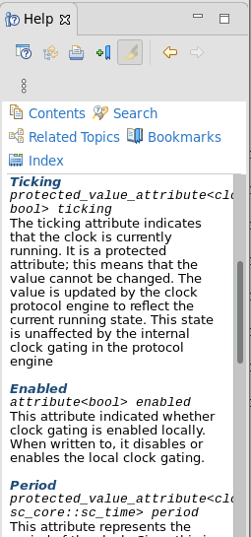
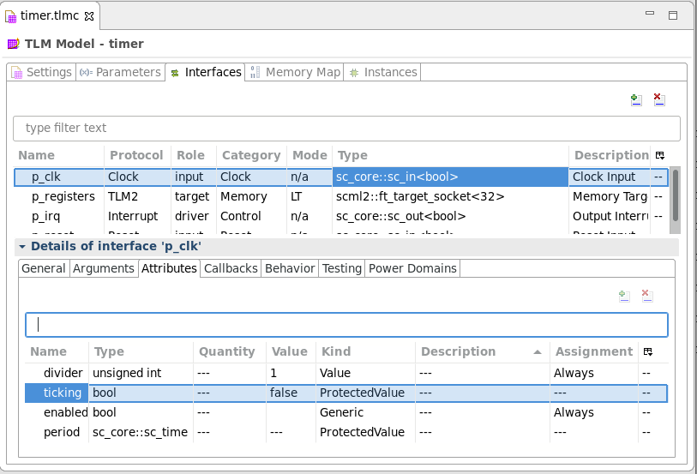
Interfaces Tab – Protocol Attributes
Context Help
Protocol (Engines)
Attributes
Configure
?
Notes:
The behavior associated with the interfaces of the model can be specified via the Interfaces tab.
Whenever a protocol is specified for an interface TLMC will insert a protocol engine into the model. The protocol engine takes care of the low level API’s of an interface and provides with an easier to use API for the model. The protocol engine has a set of attributes and callbacks that are used to refine the behavior of the interface.
Attributes can be set via the attributes subtab in the details view of the interface. The tab lists the different attributes, their type, kind etc. You can edit the value for the attributes.
For more information on the attributes, use the contextual help (CTRL-F1), when selecting an attribute the context help will show the documentation for the protocol engine and open it at the location where the attribute is explained.

Slide 10
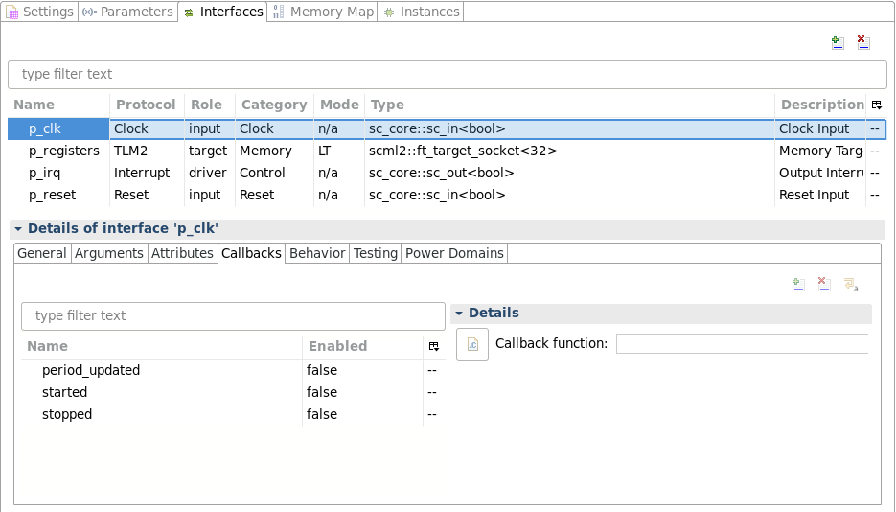
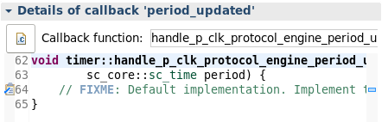

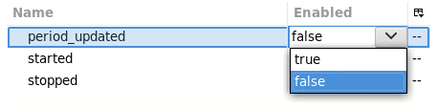
Interfaces Tab – Behavior Callbacks
Callbacks
Peephole view into actual source code
Notes:
Next to the Attributes there is the Callbacks for protocol engines. These are functions that are / can be implemented in the model and which will be called from within the protocol engine. Each protocol engine defines its own callbacks, for example the clock has callbacks for whenever the period changes, and when the clock is stopped or started. In the callback implementation you can specify the model behavior for those situations.
Callbacks can be mandatory or optional, in the example of the protocol engine the callbacks are optional as indicated by the fact that their enable setting is ‘false’. You can enable the callback by switching the enabled setting to true. Saving the model will generate a default implementation for the callback which is then accessible via the peephole view for further editing. Or you can switch to the source code as shown for the memory tab.

Slide 11
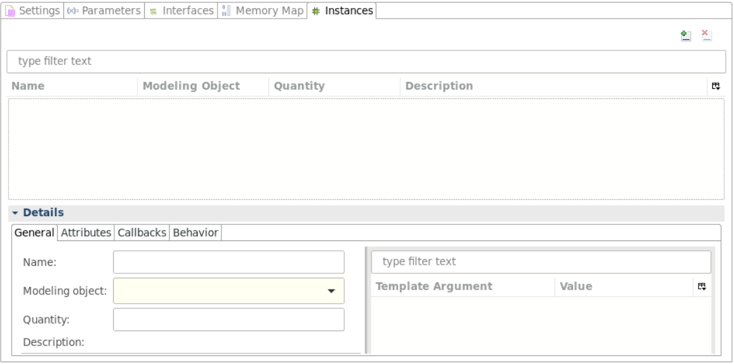
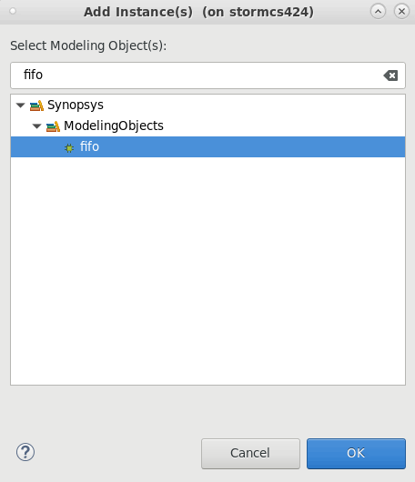
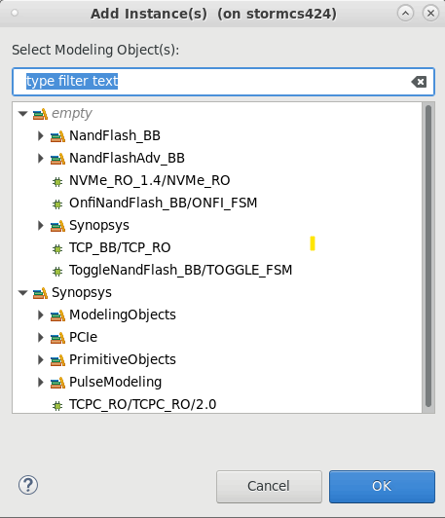
Instances Tab – Selecting Reuse Objects
Instances Tab
Enter the desired reuse modeling object type
Select the object and click OK
Enter the name as required
Click to add an Instance
or use CTRL+ N shortcut
or double click in table
Notes:
The Instances tab is the key tab where the behavior of the model can be designed. In the instances tab the internals of the model can be specified through the instantiation of reuse objects.
Reuse objects are C++ objects specialized for certain typical behavior patterns of a model. They are specified through metadata libraries that can be loaded and managed from the Library manager tab in the same way as was shown earlier for protocols. Protocol engines are in fact a special case of reuse objects.
You can add an instance via CTRL+n, give it a name and chose the type of modeling object from the drop down.

Slide 12
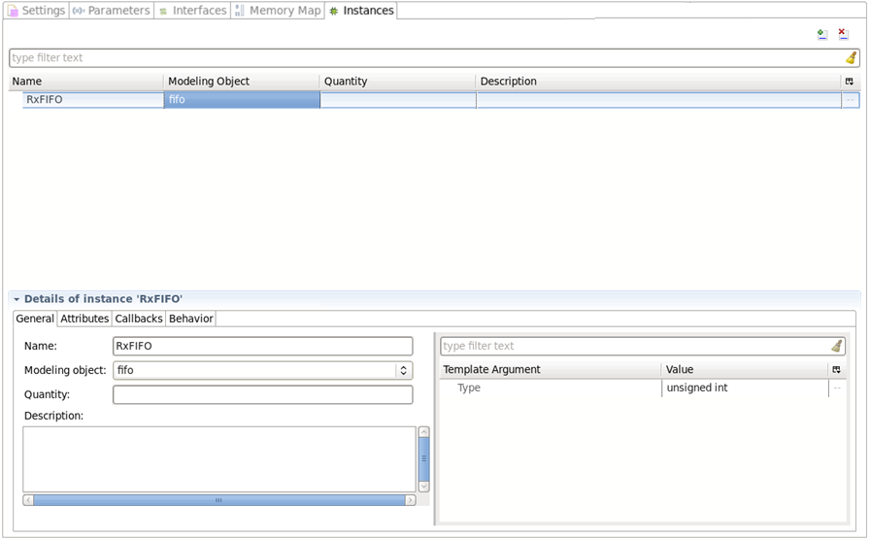
Configuring Reuse Objects
Specify Quantity to create an array of reuse objects
Template parameters for the reuse object
General
Notes:
When a modeling object type is selected you can further add a quantity to create an array of reuse object instances with the same behavior and configuration. In the Details section, you can see the General subtab where the overall settings are shown. It is also the place to specify any template parameters for the reuse object class. In the example of the Fifo, we specified that the elements in the fifo will be of type unsigned int.

Slide 13
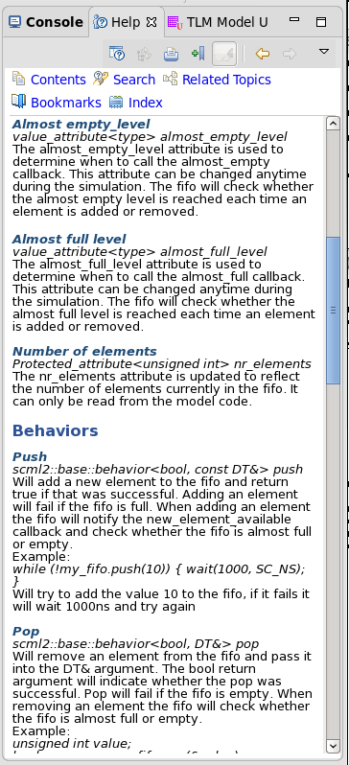
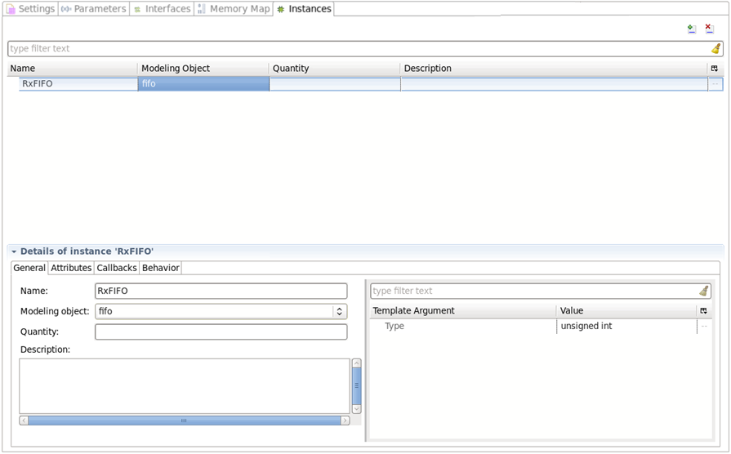
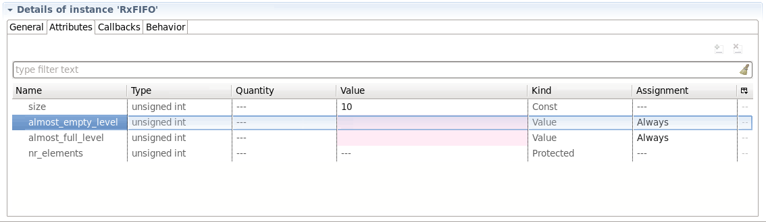
Config Reuse Objects: Attributes
Attributes
Mandatory Fields are highlighted in Red
Notes:
Next we can define the values for the attributes of the reuse object. Just like for protocol engines the contextual help will show the documentation of the reuse object opened at the selected attribute. Refer to the context help for more details on different attributes.

Slide 14
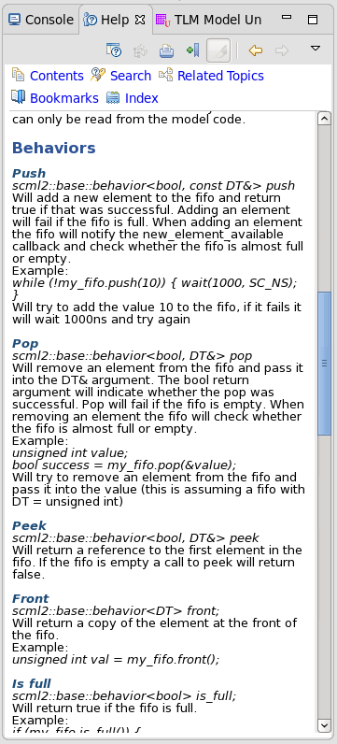
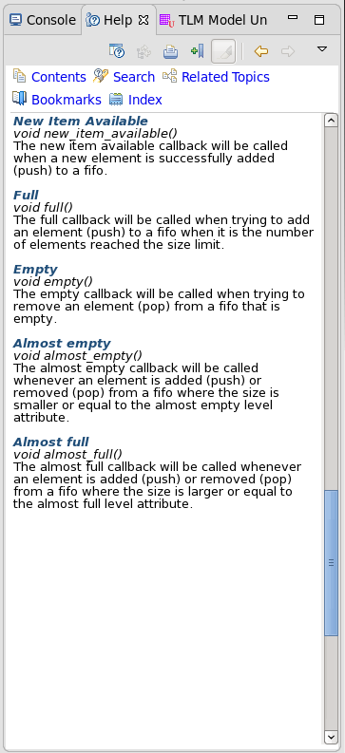
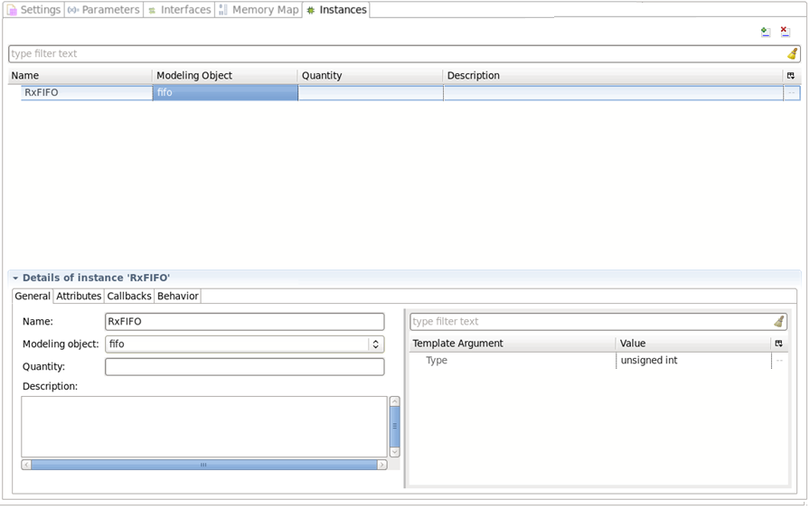
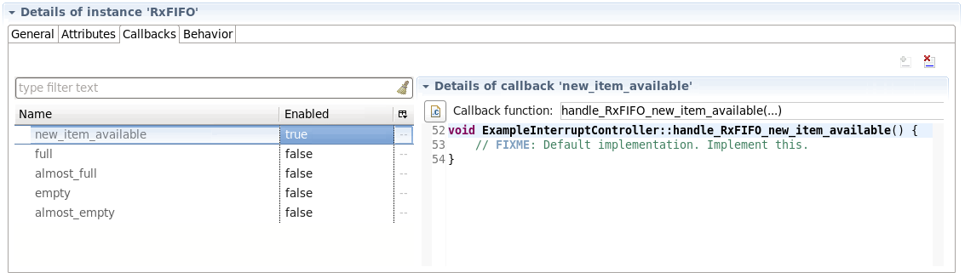
Config Reuse Objects: Callbacks
Behaviors that can be triggered on the Reuse object
Callbacks
Notes:
Once the attributes are defined it is time to have a look at the callbacks for the reuse object instance. Each reuse object type will define its own callbacks, that can either be mandatory or optional. When a callback is enabled TLMC will generate the necessary code to define the callback and provide with a default implementation, which you then can further refine via the peephole view.
Also for callbacks the documentation can be accessed via the context help.
Finally a reuse object also defines a number of behaviors. These are functions implemented by the reuse object that can be called from other behaviors or callbacks in the model. The documentation of the behaviors can be reviewed from the context help view.

Slide 15
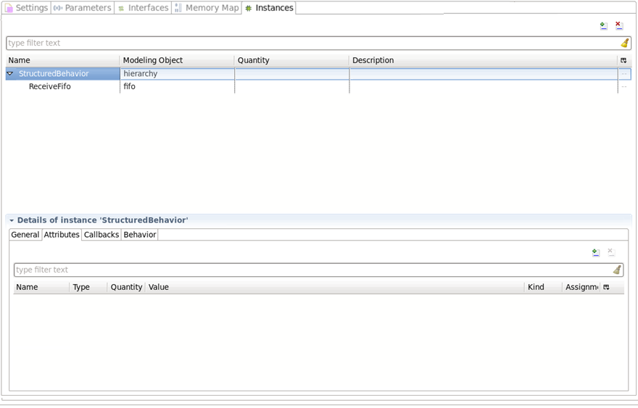
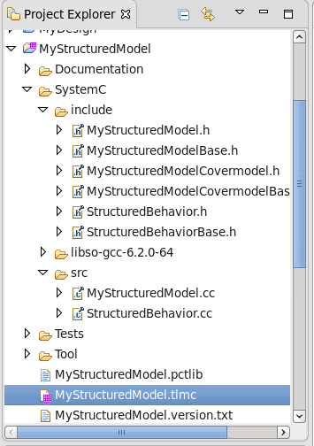
Instances Tab – Hierarchy
Hierarchical Reuse Instance
Instance within Hierarchy
Each hierarchy has own C++ files
Notes:
A special type of reuse objects are those that implement a hierarchy in the Instances Tab. Hierarchies can be used to structure the behavior of a model into subclasses and to encapsulate sub-behavior of a model.
When adding a hierarchy, new reuse objects can be added into the hierarchy in the Instances table.

Slide 16
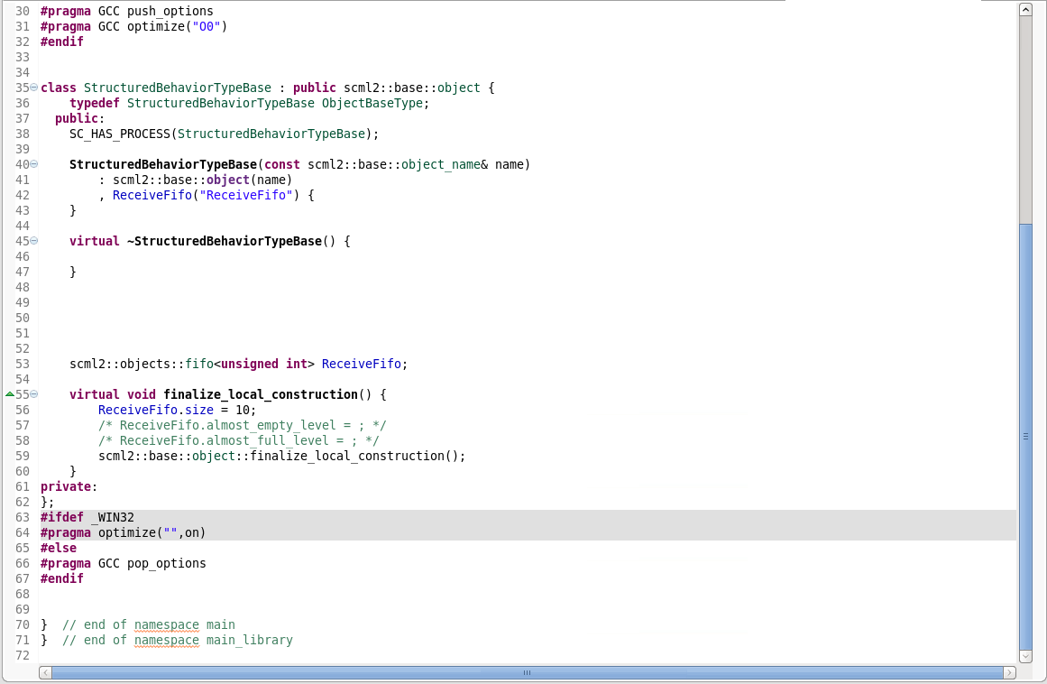
Instances Tab – Hierarchy
Each hierarchy is defined in separate class
Instances in a hierarchy are members of hierarchy class
Each hierarchy has own C++ files
Notes:
The TLMC code generator will generate the code for the hierarchy into a separate class, the instances within the hierarchy will be members of the hierarchy class. The code for the hierarchy is generated into separate header and cpp files.

Slide 17
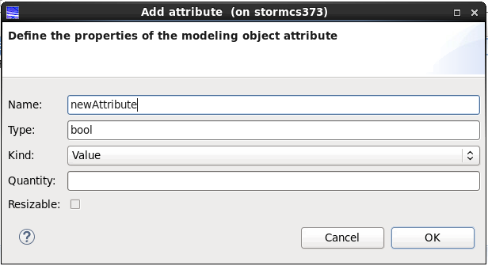
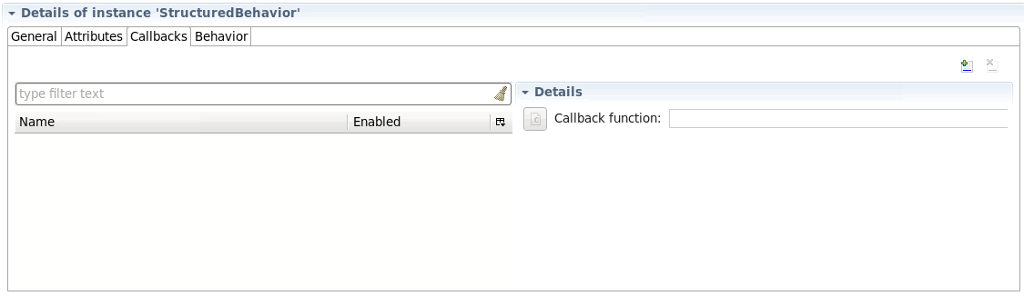
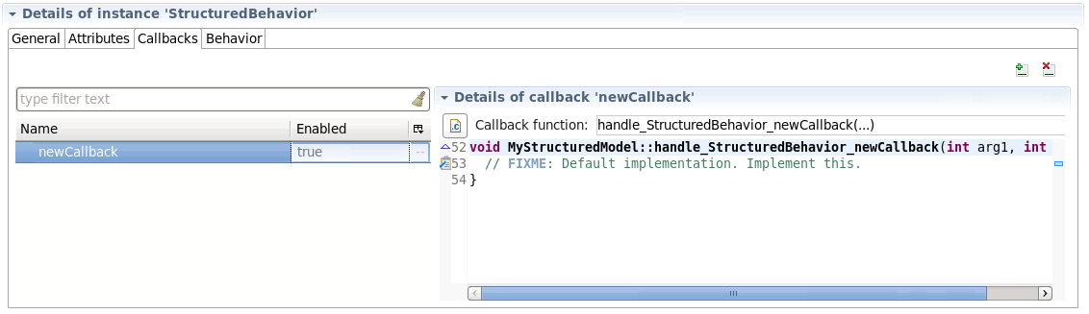
Instances Tab – Hierarchy
Specify Name, Type and Kind of attribute, Quantity to create an array, and click OK
Click to add an Attribute to the table
Attributes
Implement Callback in peephole or source code
Notes:
For a hierarchical instance it is possible to create dedicated attributes, callbacks and behaviors. These define the interface between the behavior that is encapsulated in the hierarchy and the rest of the model.
Attributes are member variables of the hierarchy class and can be added through the Attributes subtab.

Slide 18
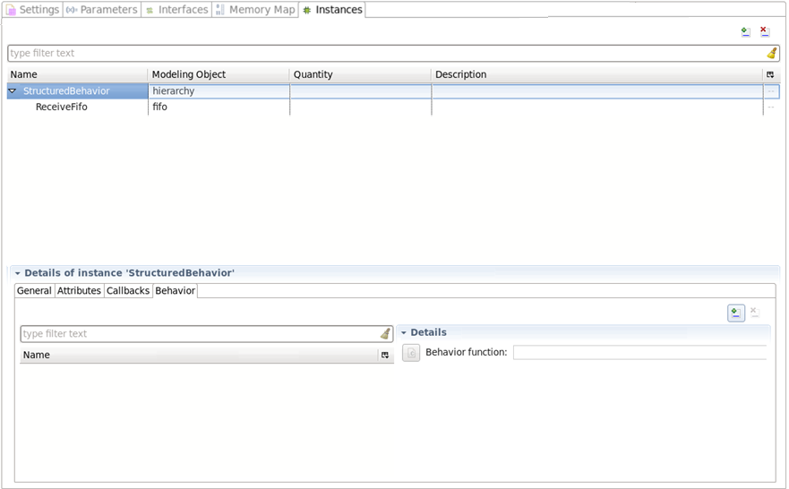
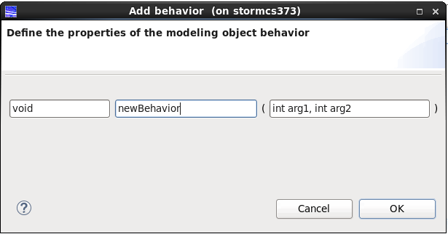
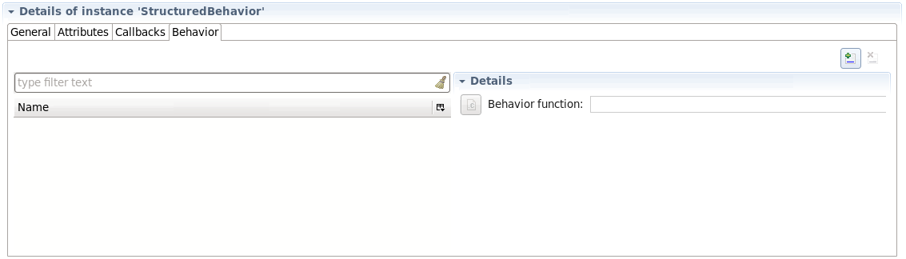
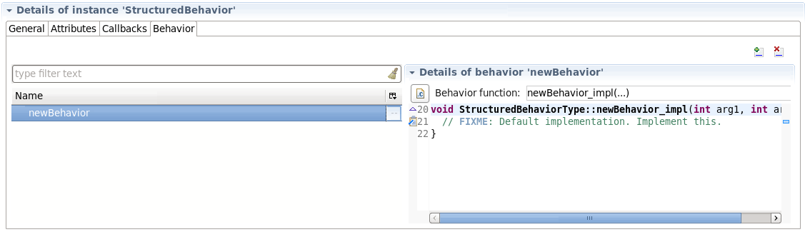
Instances Tab – Hierarchy
Specify the Name, Return value and Arguments of the behavior function.
Click to add an Behavior to the table
Behavior
Implement the behavior in source code or via the peephole view
Notes:
Behaviors are functions that are implemented in the hierarchical instance and that can be called from the model.

Slide 19
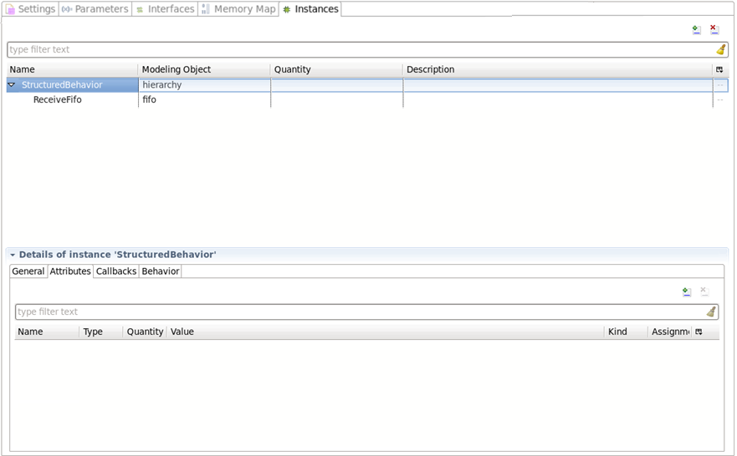
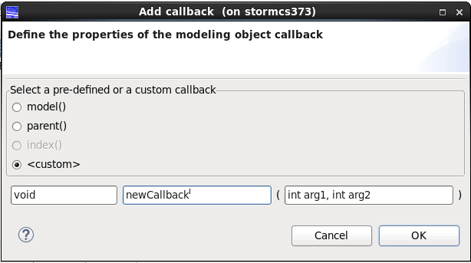
Instances Tab – Hierarchy
Specify Name, Return value, and Arguments of the callback function. Some of the custom or predefined callbacks provide access, to the
Model itself
Parent hierarchy
Index of this instance in an array of hierarchies
Click to add an Callback to the table
Callbacks
Implement Callback in peephole or source code
Notes:
Callbacks are functions that are implemented in the model or parent hierarchy and that can be called from within the hierarchical instance.

Slide 20
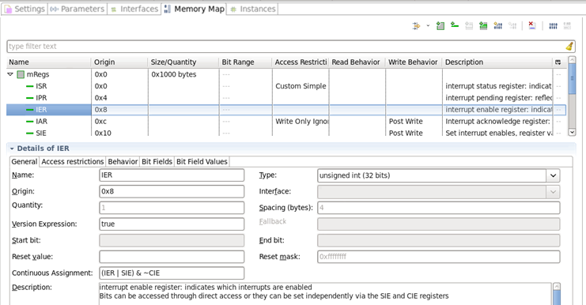
Continuous Value Assignments
Expresses relationships between objects in a Model
Defined through
an expression
Applies to
  The value of registers
  and bitfields
  The value of a reuse
  object attribute
Registers
& Bit-fields
The value will be updated each time one of these registers change their value
Value of a Register is defined as an expression of other registers.
Notes:
Continuous assignments can be used for registers and bit-fields, protocol attributes and attributes of reuse object attributes. In this type of assignment, value is defined as an expression of other registers.
The value will be updated automatically when any of the registers used in the assignment change their value.

Slide 21
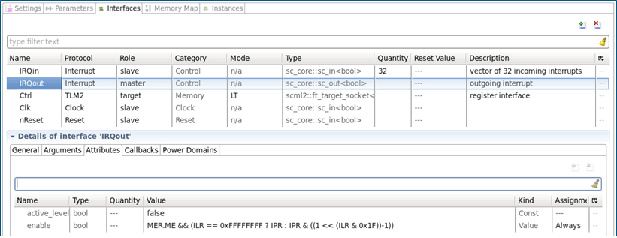
Continuous Value Assignment Evaluation
Expression is evaluated whenever
  Any of the register/bitfield arguments change value
  Any of the attribute arguments are set (i.e. also when they do not change value)
Result of the expression is assigned to the attribute or register
Continuous Assignments are independent of read/write callbacks or any other assignments to the register or attribute
Each assignment will
trigger all dependent
continuous assignments
Infinite loops are detected
and reported as an error
Always assignments are continuous
Value of enable attribute is updated whenever one of the registers used in the continuous assignment changes
Notes:
For example, value of the enable attribute here is updated whenever one of the registers used in the continuous assignment changes its value.

Slide 22
Different Types of Attributes
Attribute Kind | Type | Description
Value Attribute Generic Attribute | Data Type (DT) like int, double, string, ...) | Can be read/written from within model as well as from within reuse object Can be used as a member of type DT Can trigger continuous value assignments, can also be used in them
Const Attribute | DT | Can be set only once, is to be used for initialization of reuse object Cannot trigger continuous value assignments Can be used in continuous value assignment as a constant
Protected Attribute | DT | Can be read from the user code can only be set from within reuse object Can trigger continuous value assignments, can also be used in them
Trigger Attribute | --- | Can only be used to trigger behavior in reuse object Cannot trigger and cannot be used in continuous value assignments Can be defined via continuous value assignment (dependency list)
Attribute Type | Description
Array | Certain attributes are defined as an array, possibly flexible in size This is similar to a C++ array. The array is not an object itself.
Struct | Represents a struct element in a RO. The struct cannot be used as an object in TLMC. Its members are viewed as regular attributes.
Notes:
The table defines supported kind and type for the attributes of the reused object. For more details, refer to the VP documentation.

Slide 23
Hands On Labs on this topic
Module 1 Lab C: Implement the Behavior of an Interrupt Timer
Your task for this lab is to the implement the ‘set-and-forget’ behavior of the timer as described in the specification of the interval timer and as listed in the feature tracking spreadsheet TimerFunctionalityTracking.xlsx
During this lab, you will see how to create TLM models in an efficient way, using TLM Creator’s productivity features such as callbacks, continuous assignments, a library of re-use objects, etc.
Module 2 Lab B: Implement the Behavior of an SPI Controller
Using the library of re-use objects in TLM Creator you can keep the amount of code you have to write and test at a minimum. Features such as continuous assignments also help to keep the model implementation concise and efficient.
Notes:
Accompanied Lab Modules Overview !

Slide 24

Thank You

